Slide 1
Voice and Choice
November 7th 2016 Part I

Slide 2
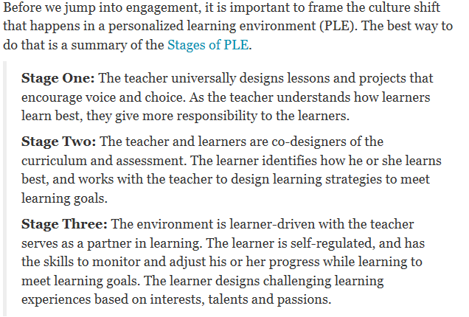
What is Voice and Choice?
Taken from: http://www.centerdigitaled.com/blog/learner-voice-and-choice-leads-to-engagement.html which can be found on Crissy’s PL website http://cvesidealab.weebly.com/personalized-learning.html

Slide 3
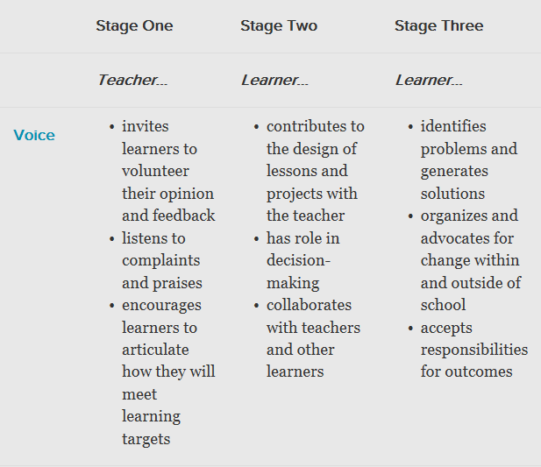
Stages of engagement in voice

Slide 4
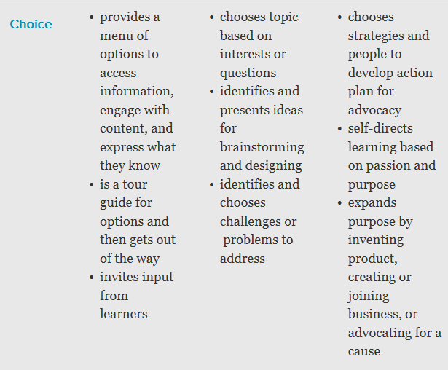
Stages of engagement in choice

Slide 5
Other resources and articles
In a personalized learning environment, the learner fully understands how they learn. With this knowledge, the learner is empowered to have a voice and choice with their learning. In personalized learner-centered and learner-driven environments, they can be active and engaged participants in their learning.
From: http://www.personalizelearning.com/2012/10/the-expert-learner-with-voice-and-choice.html
If you’re ready for the advanced level of understanding of Voice and Choice and ready to take it to the next level try this article. It has a link to a great chart on the difference between Personalization, Differentiation and Individualization.
http://www.personalizelearning.com/2012/02/10-tips-to-encourage-voice-and-choice.html

Slide 6
Webb’s DOK
What do the different levels mean? *DOK 1 *DOK 2 *DOK 3 *DOK 4
How do they correlate to Bloom’s Taxonomy?

Slide 7
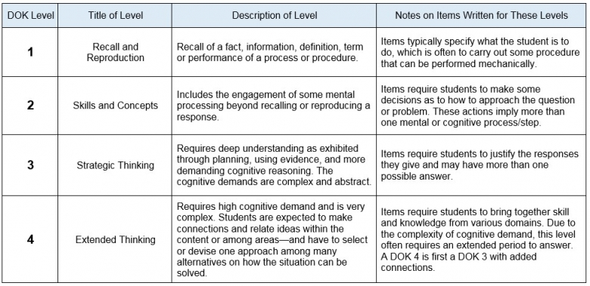
DOK Examples

Slide 8
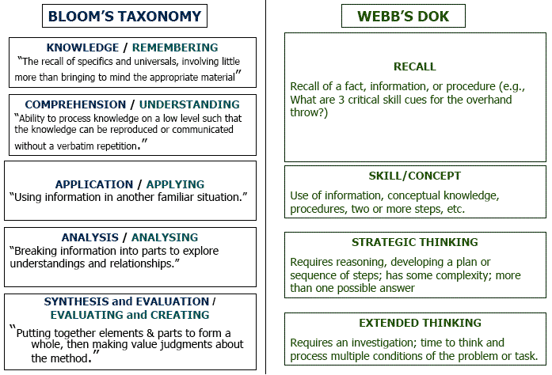
DOK and Bloom’s

Slide 9
What are the different learning styles?

Slide 10
How Do DOK and Learning Style of an activity fit with Voice and Choice?
Poster Activity *Use the cut apart choice board activities to put on the DOK and Learning Style poster
Gallery Walk *Walk to different poster (everyone had a different group of choice board activities) *What activities that fit into each area? *How rigorous the activities were *How much Voice and Choice students had on these projects

Slide 11
Discussion
What did you notice about the posters/activities?
How much Voice and Choice did students have?
How rigorous were the tasks?
What DOK were most of them?
What learning styles were “hit” the most frequently?
Look at the examples you brought with you. Discuss with your table group where majority of the activities in your example would fall.
What are some GREAT activities you already have on your choice boards that you feel offer voice and choice, rigor and address multiple learning styles?

Slide 12
how do we incorporate all of this?
Looking at your current choice board, consider the topics below:
Voice
Choice
DOK variety
Learning Style variety
Amount of paper/grading/presentation required
How well does it reinforce/address the chosen standard?

Slide 13
Application Time!
Work with your grade level to revise a current choice board to ensure it incorporates the different aspects of voice and choice.
Voice
Choice
DOK variety
Learning Style variety
Amount of paper/grading/presentation required
How well does it reinforce/address the chosen standard?

