Slide 1
Implementing Just-in-Time Direct Instruction

Slide 2
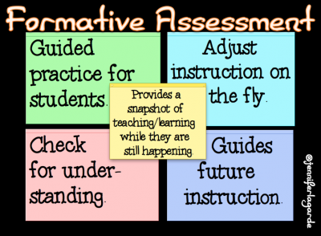
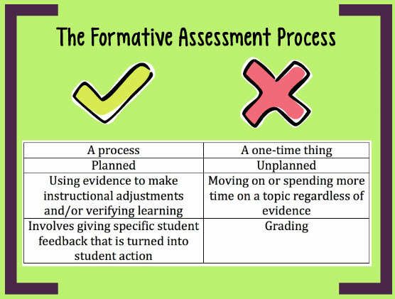

Slide 4
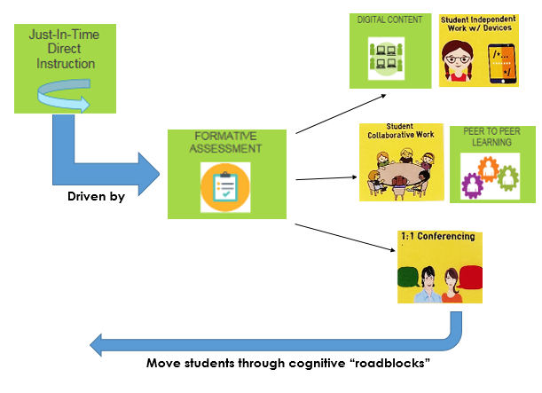
Provide enrichment & guided practice as needed

Slide 5
gaps in learning
Without Just-In-Time
Direct Instruction
Over time
misconceptions
Incorrect strategies

Slide 6
Efficient | Effective
Formative Assessment | Just-in-Time Direct Instruction

Slide 7
Where Do We Begin?

Slide 8
Flexible Grouping
in a Workshop Setting
Project Based Learning
(PBL)
Inquiry Based Projects
Driven by Formative Assessment
Just-in-Time Direct Instruction -Implementation

Slide 9
Flexible Grouping
Project Based Learning
Inquiry Based Projects
End Goal - Varied Strategies w/ Embeded Choice and Voice

Slide 10
Flexible Grouping
in a Workshop Setting

Slide 11
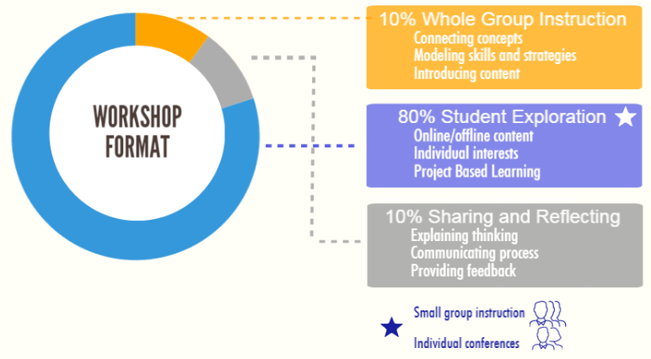

Slide 12
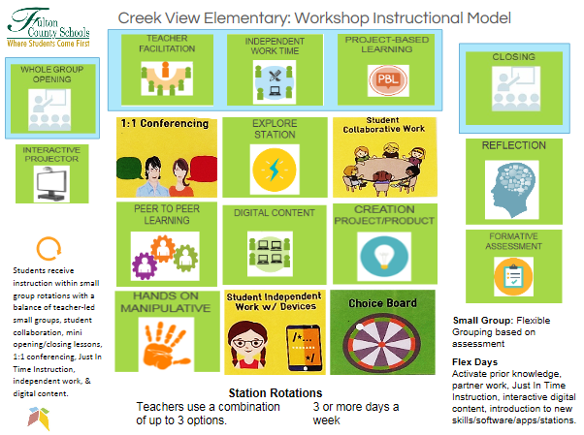

Slide 13
Efficient | Effective
Formative Assessment | Just-in-Time Direct Instruction

Slide 14
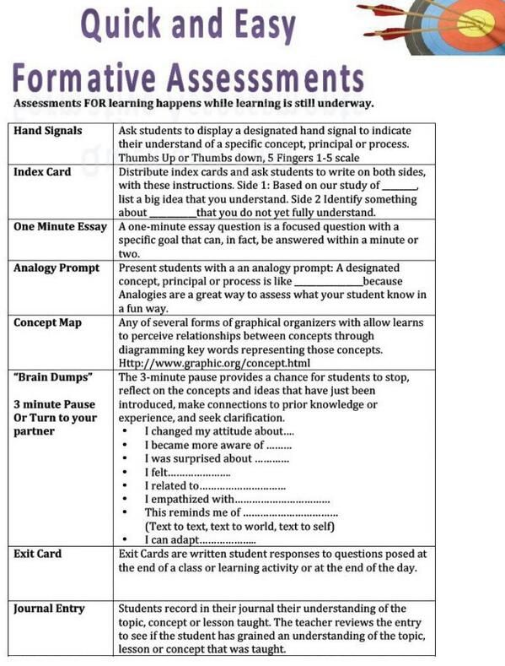
OFFLINE

Slide 15
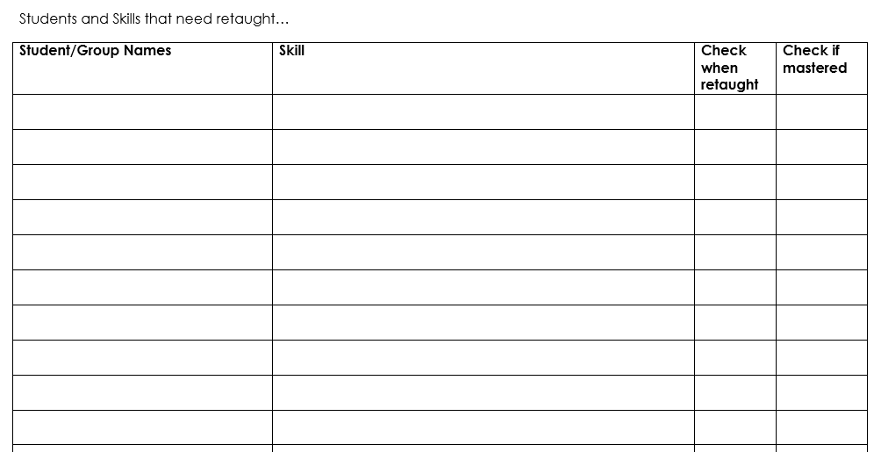
Reteach Folder

Slide 16
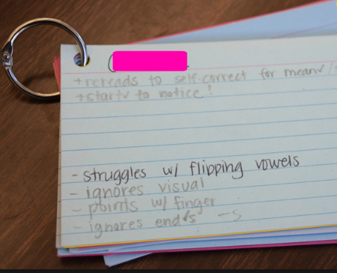
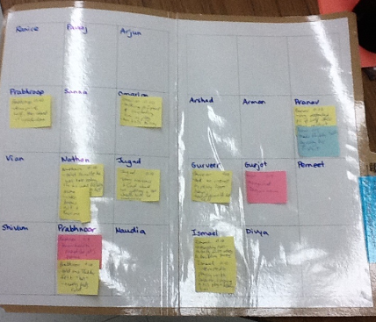
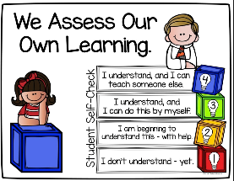
OFFLINE
Post-It Notes
-Quick Scan
Anecdotal Notes
-Show of Hands*
Notes:
*Growth Mindset

Slide 17
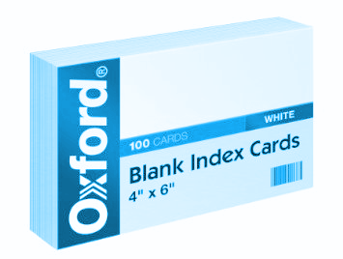
Link to Directions
OFFLINE
4” x 6” Index Card
-Divide into ¼s
-Collect and quickly
sort for Just-in-Time
Direct Instruction

Slide 18
3nd Grade Rounding:
3nd Grade Rounding:
CCSS.Math.Content.3.NBT.A.1 Use place value understanding to round whole numbers to the nearest 10 or 100.

Slide 19
Just In Time Direct Instruction/Differentiation Based on formative assessment…
Critical Thinking (higher level/enrichment) - Independent
Watch Brainpop: https://jr.brainpop.com/math/numbersense/rounding/
Play game https://jr.brainpop.com/games/battleshipnumberline/
On Level (knew some) – underline place value/ rounding chart if needed with teacher facilitation or partner
Low Level – Use number lines by 10s with teacher

Slide 20
ONLINE - Lower Grades
web.seesaw.me
@Seesaw

Slide 21
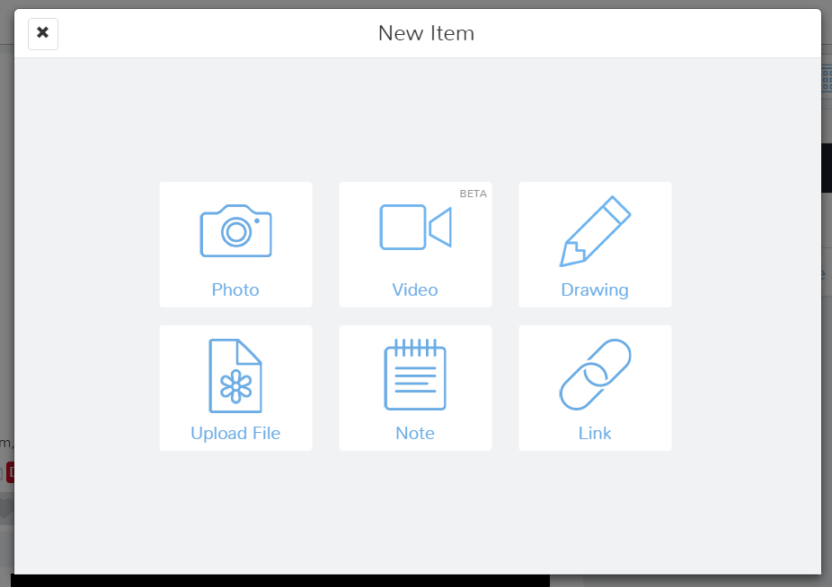
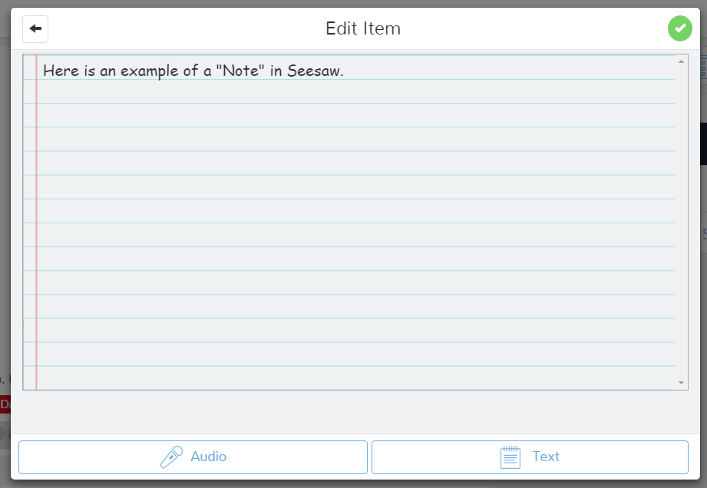
iPad/Surface Allow for Drawing Capability too.
Student Created Artifacts

Slide 22
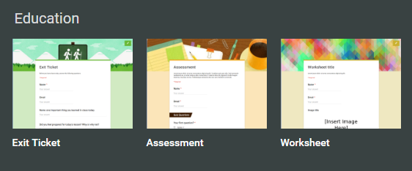
forms.google.com
ONLINE - Upper Grades
Notes:
5th Grade: https://goo.gl/0vHnv8
4th Grade: https://goo.gl/sQCE5v

Slide 23
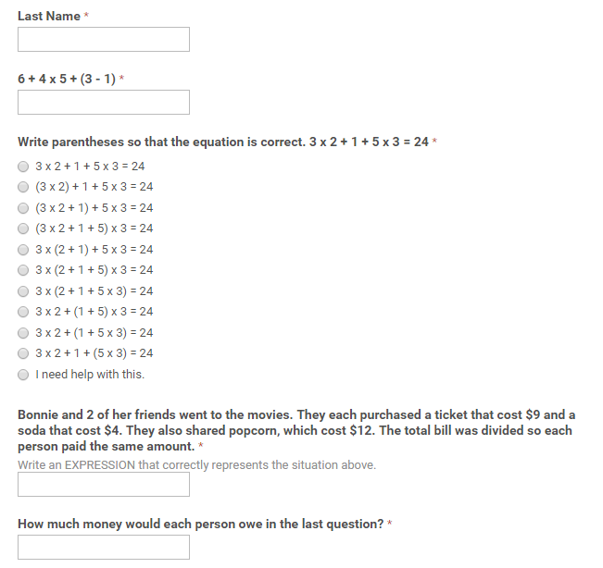
Traditional Form that Follows Direct Instruction

Slide 24
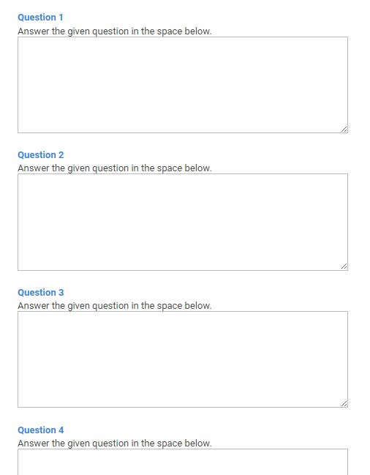
Open Ended Form
Never Needs Editing
Keeps the same web address

Slide 25
classroom.google.com
ONLINE - Upper Grades
Notes:
Google Classroom Embeded: https://classroom.google.com/c/MTgzNDQyODM1/a/MTI5MjYxMjQxN1pa/details
Mack Classroom: https://classroom.google.com/c/NTcxMDg5NDY2
Student Journal Example: https://docs.google.com/presentation/d/16rdPhzGXB-drYRp7kEOTCXbGvDDJQf3T2AN4I2z7CNM/edit#slide=id.p

Slide 26
Efficient | Effective
Formative Assessment | Just-in-Time Direct Instruction

Slide 27
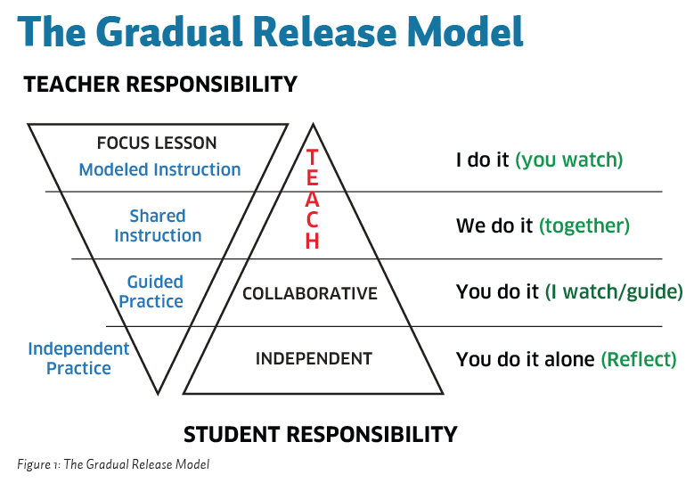
Structure
Does not include:
Long Hooks
Excessive Examples
Solicited Answers from multiple students
If it is longer than 10-15 minutes you are teaching too much material (in one sitting).
The Architecture of a Mini-Lesson

Slide 28
Flipped Instruction
Not Just for Homework
Junior
Original
ESL

Slide 29
Flipped Instruction
Not Just for Homework
Whiteboard Apps
This allows for more specific content delivery.

Slide 30
Re-teach Video (made in minutes with Screen Chomp app)
Adding Numbers on a Number Line
Teaching Video by search
Addition Using a Number Line
ShowMe.com – Search for videos made in Show Me App
Rounding Numbers
Formative Assessment or Extension Activity
Student show learning – Place Value Models

Slide 31
Project Based Learning (PBL)
Down the road………..

Slide 32
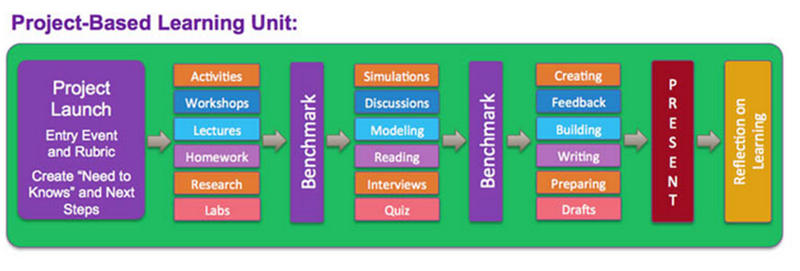
Hypothesize potential cognitive “roadblocks” and plan for Direct Instruction.

Slide 33
Anecdotal Observations
Pretest
Quiz
Classwork
Summative
Rubric
Formal Observations

Slide 34
On your own…
Look at the next standards/concepts you will teach in the next few weeks.
What quick effective formative assessments can you give to direct your instruction?
Create or locate digital resources for skills
How will the formative assessment guide your instruction?
What form of direct instruction will you implement?

