Slide 1
iMovie Turn your pictures and videos into movie magic.

Slide 2
iMovie is easy to use, and it’s free! iMovie trailers let you quickly create fun, Hollywood-style movie trailers. Choose from a range of templates in almost any genre, pick your studio logo, and type in your movie title and credits. Then add photos and videos to the storyboard.

Slide 3
Verbs uses the Superhero template.

Slide 4
Students and teachers are making trailers to do things like demonstrate their learning, explain vocabulary words, document experiments, preview novels or textbook chapters, summarize historical events and promote school activities.

Slide 5
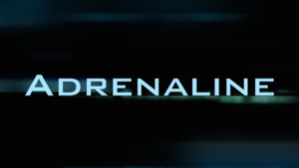
The movie trailer component of the iMovie app for the iPad includes 14 themes to pick from. The transitions and animations are already built-in, but students can do some editing of these themes to showcase their work in a different way.
(iMovie for Mac has 14 additional templates)

Slide 6
European Explorers uses the Swashbuckler template.

Slide 7
Some ideas for using movie trailers across the curriculum include: - A movie trailer is a perfect summarizing activity! - It can act as a “teaser” as an introduction to a presentation or student project. - Have students create an “end of course or class” trailer to introduce others to the course - Students can create an advertisement for a product they created in a STEM class. - Movie trailers can put a new spin on the “all about me” presentation. - Students can help create promo pieces for upcoming school events, class elections, and fund-raising activities - A movie trailer can be a very short, but exciting digital story, summarizing the content and/or process in any curriculum area - Using movie trailers as a way to introduce different viewpoints

Slide 8
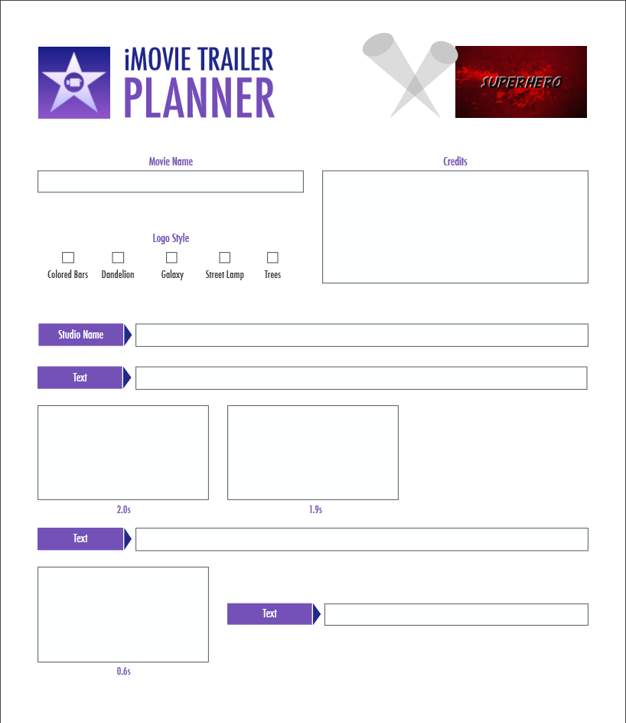
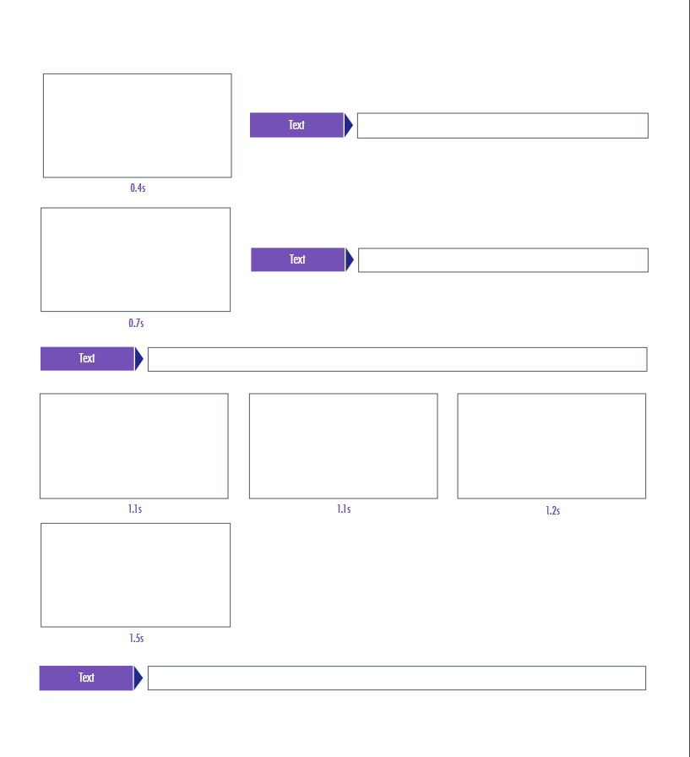
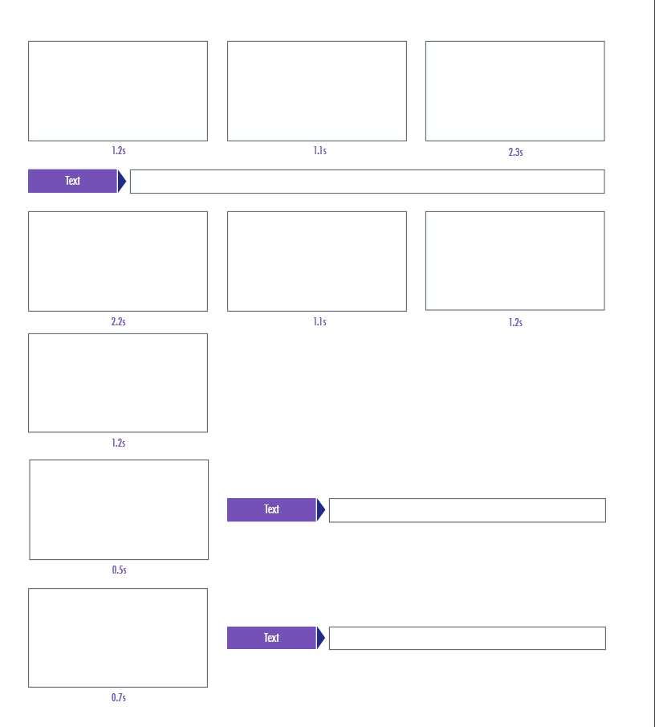
The first step in making an iMovie movie trailer is taking a look at the script and storyboard pages. It is a good idea for students to spend some time thinking about the theme of the trailer they want to use and start gathering the pictures and videos to use in the production. To help plan trailers with more original text and shots, I found a fillable PDF for each template. They will be very helpful as students get their ideas together. You can get the fillable PDF’s here: http://learninginhand.com/blog/2014/8/6/plan-a-better-imovie-trailer-with-these-pdfs

Slide 9
Diary of a Wimpy Kid trailer uses Teen template.

